Slide 1

Field Outreach and Community Engagement at SANLAAP
Internship Report Presentation
Afroja Khatun | B.Tech CSE | IILM University, Greater Noida
Internship Period: 1 June 2026 – 30 June 2026

Slide 2
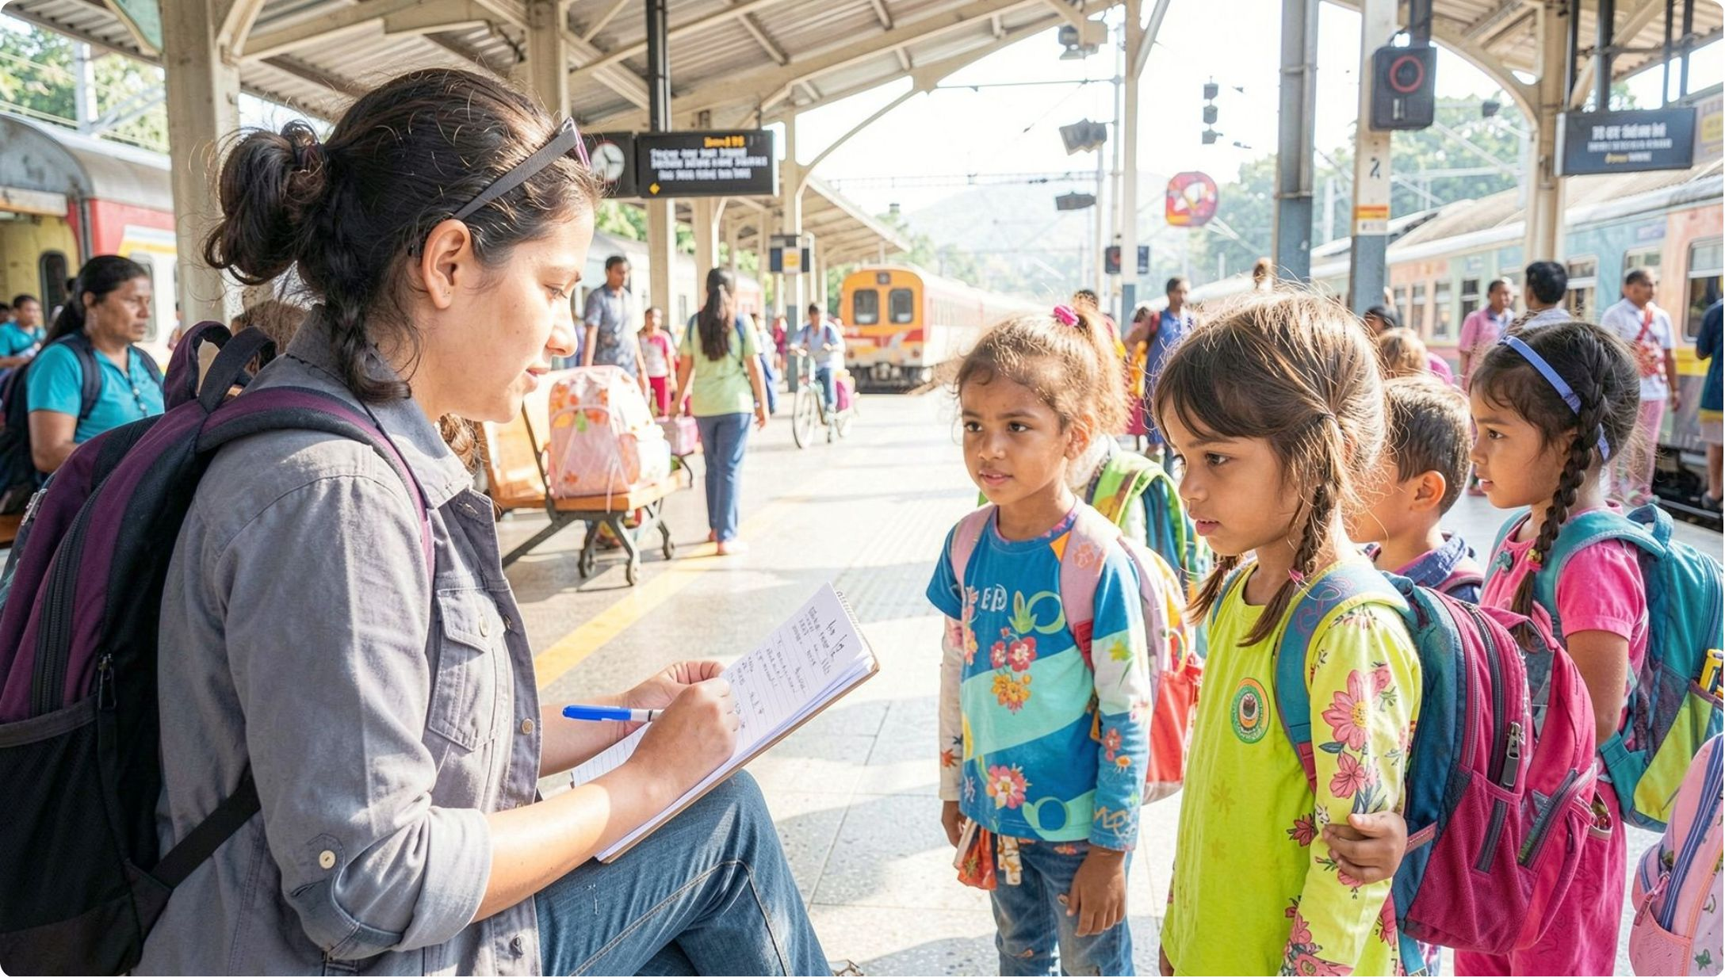
About the Internship
Scope of Engagement
Practical exposure to field outreach and community engagement
Focus on children and vulnerable groups
Field observation and direct interaction
Understanding child-protection procedures and mechanisms
Awareness activities and educational material preparation

Slide 3
About SANLAAP
Mission
Focus
Prevention of trafficking and exploitation of women and children
Rehabilitation and empowerment of vulnerable women and children
Approach
Location
Field-oriented and community-focused activities
Internship centre associated with Sealdah Station, Kolkata

Slide 4
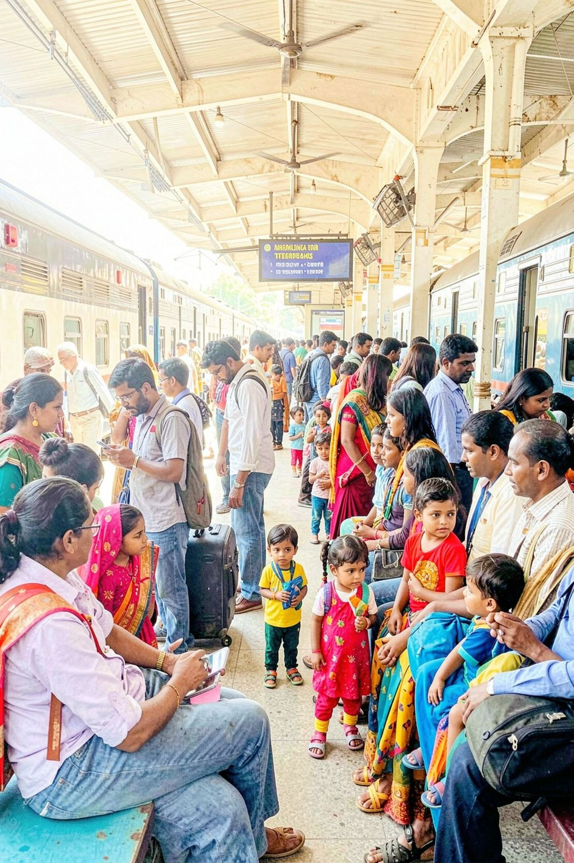
Problem Statement
Vulnerability at Railway Stations
Children around railway stations face high-risk situations — separation from family, lack of supervision, and exposure to exploitation.
Gaps in Early Identification
Without trained outreach workers, vulnerable children often go unidentified and disconnected from child-protection systems.
Need for Intervention
Structured outreach mechanisms and coordination with authorities are essential for prevention and timely support.

Slide 5

Internship Objectives
1
Field Observation
Understand outreach and observation techniques used in railway-station settings
2
Child Identification
Identify children who may be vulnerable, separated, or at risk
3
Child Help Desk
Learn procedures and role of the Child Help Desk in protection systems
4
Legal Frameworks
Study the Juvenile Justice (JJ) Act and its practical application

Slide 6

Field Outreach Process
Safe Interaction
Basic Information
Child Help Desk
Observation
Identification
A structured, step-by-step approach ensures every child in need is identified, assessed, and connected to appropriate protection mechanisms.

Slide 7
Major Internship Activities
Orientation & Observation
Child Help Desk
Training in field observation techniques and outreach protocols at Sealdah station
Learned procedures, referral pathways, and the Juvenile Justice Act in practice
DIC Visit
Awareness Materials
Visited the Daycare and Information Centre to understand rehabilitation support services
Prepared women-focused educational leaflet; participated in community awareness programmes

Slide 8


Awareness & Community Engagement
Key Community Engagement Initiatives
Women-Focused Leaflet: Educational material addressing women's rights, safety, and available support resources
International Day Against Drug Abuse: Awareness programme at Vidyanagar College — outreach to youth and community members
Community Outreach: Engaged local communities on child protection and trafficking prevention
Educational Material: Developed targeted resources for vulnerable populations
All awareness activities were conducted under supervision of SANLAAP field staff.

Slide 9





Internship Methodology
Orientation
Training on procedures, protocols, and sensitivity
Observation
Field-based learning and active monitoring
Guided Participation
Supervised engagement in live outreach activities
Documentation
Recording activities, observations, and outcomes
Reflection
Analysis and structured learning from field experiences

Slide 10

Weekly Internship Reports
Documentation Framework
Documentation: Weekly reports prepared throughout the full internship period
Content: Activities performed, field experiences, and direct observations
Learning Tracking: Learning outcomes and measurable skill development
Outreach Record: Community engagement and awareness activity logs
Reflection: Professional insights and personal growth notes
Submission: Regular reporting to supervisors and mentors

Slide 11

Learning Outcomes
Field Skills
Improved observation and communication skills in real field settings
Child Protection
Deeper understanding of protection mechanisms, support systems, and legal frameworks including the JJ Act
Material Development
Practical experience preparing targeted awareness and educational materials
Professional Conduct
Teamwork, sensitivity, confidentiality, and responsible engagement with vulnerable communities

